Slide 1
Benefits Of The Security Transformation
Key Benefits:
Prevention of attacks
Prevention of fraud & pilferage
A reliable & robust IT setup

Slide 2
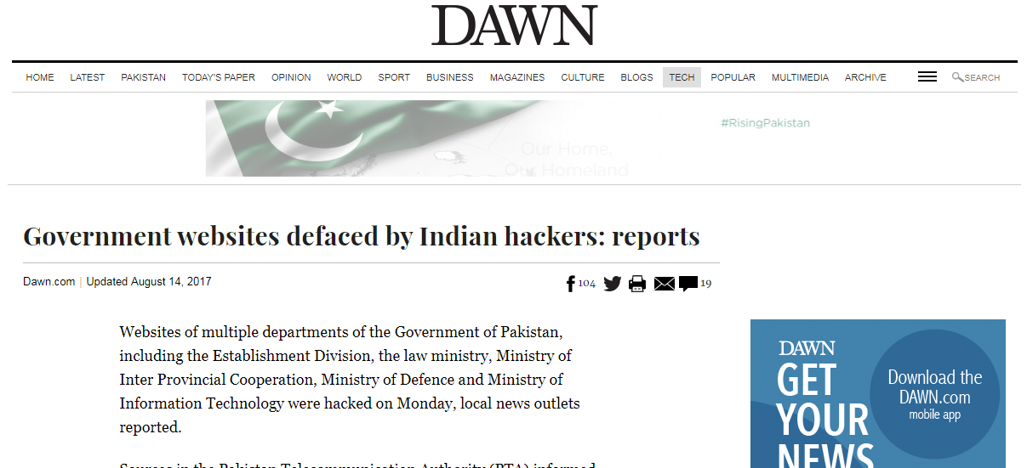
Benefits Of The Security Transformation

Slide 3
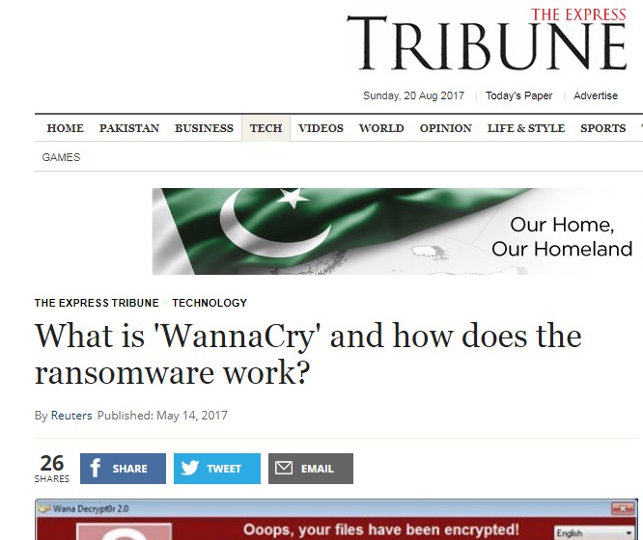
Benefits Of The Security Transformation

Slide 4
Benefits Of The Security Transformation
Impact of attacks:
Loss of market goodwill
Loss of customer confidence
Regulatory fines, legal consequences

Slide 5
Benefits Of The Security Transformation
Prevention Of Fraud & Pilferage:
An effective Information Security Program makes it harder to conduct fraud, abuse, or misuse without getting detected
Controls in business process
Audits

Slide 6
Benefits Of The Security Transformation
A Reliable & Robust IT Setup:
Business continuity & DR
Redundancy
Backups
Capacity management
Change management
Incident management

Slide 7
Benefits Of The Security Transformation
Conclusion:
An effective Information Security Program (achieved through an Information Security Transformation) is essential wherever an IT setup exists
Not a luxury but an imperative
END

